Slide 1

Object Detection in Deep learning
ADVANCE MACHINE LEARNING
By: Aksa Taniya

Slide 2
Introduction
Object detection in deep learning is a computer vision task that involves identifying and locating objects within images or videos. Deep learning, particularly convolutional neural networks (CNNs), has revolutionized object detection by enabling automatic feature learning from raw pixel data. Object detection techniques include two-stage methods like R-CNN, Fast R-CNN, and Faster R-CNN, as well as one-stage methods like SSD and YOLO.
Recent advancements in object detection include feature pyramid networks (FPN), attention mechanisms, and state-of-the-art models like EfficientDet and Detectron2. Object detection has many real-life applications, including autonomous driving, surveillance, medical imaging, and robotics.

Slide 3
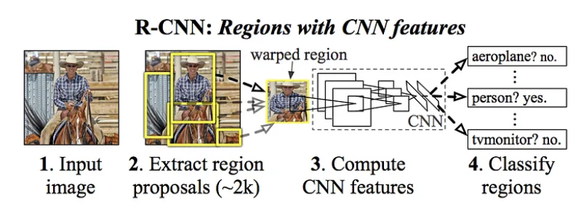
Types of object detection methods:
R-CNN (Region-based Convolutional Neural Networks)
R-CNN was one of the pioneering methods in deep learning-based object detection. It uses selective search to generate region proposals and then applies a CNN to extract features from each proposal.

Slide 4
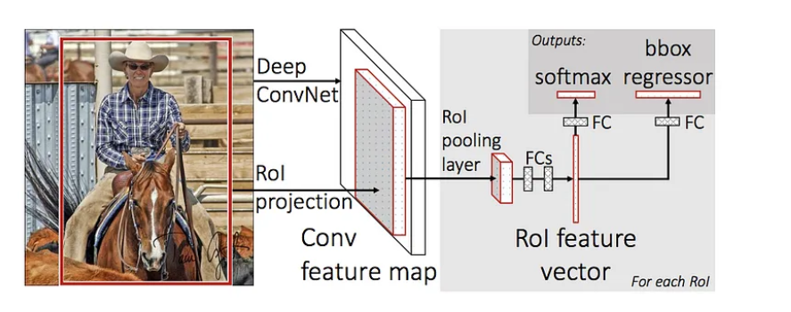
Fast R-CNN
Building upon R-CNN, Fast R-CNN improves efficiency by sharing the convolutional features across proposals. It introduces the region of interest (RoI) pooling layer to extract fixed-sized features from the convolutional feature maps.

Slide 5
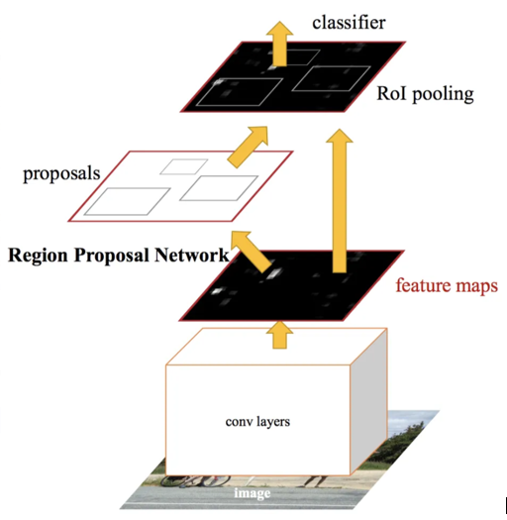
Faster R-CNN
Faster R-CNN further enhances speed and accuracy by introducing a region proposal network (RPN). The RPN shares the convolutional features with the detection network and predicts object proposals directly.

Slide 6
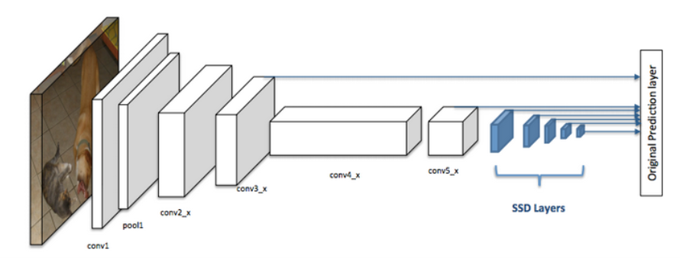
Single Shot MultiBox Detector (SSD):
SSD is a widely-used one-stage object detection method. It divides the input image into a grid of cells and predicts multiple bounding boxes and class probabilities at each cell for various object scales and aspect ratios.

Slide 7
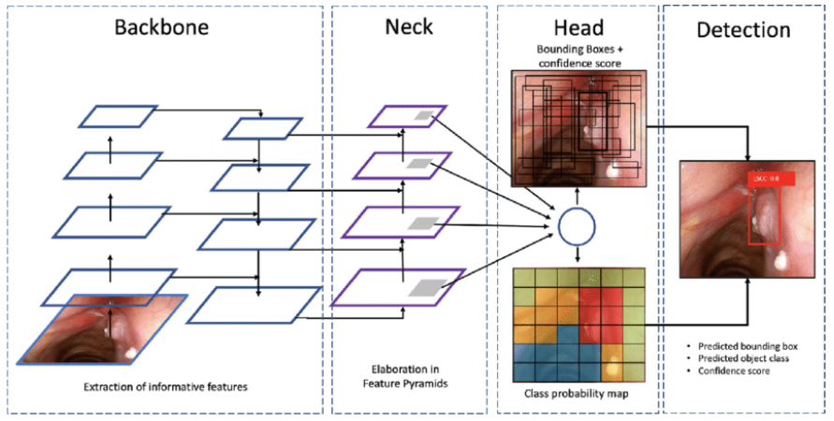
You Only Look Once (YOLO):
YOLO is another efficient one-stage object detection method. It divides the input image into a grid and predicts bounding boxes and class probabilities directly using a single neural network. YOLO achieves real-time performance by performing detection at multiple scales and using anchor boxes for accurate localization.

Slide 8
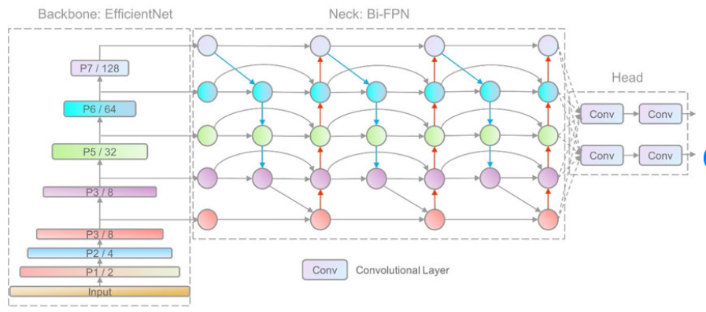
EfficientDet:
EfficientDet introduces a compound scaling method to optimize both accuracy and efficiency. It scales the backbone, feature network, and box/class prediction network simultaneously to achieve better trade-offs between these factors.

Slide 9
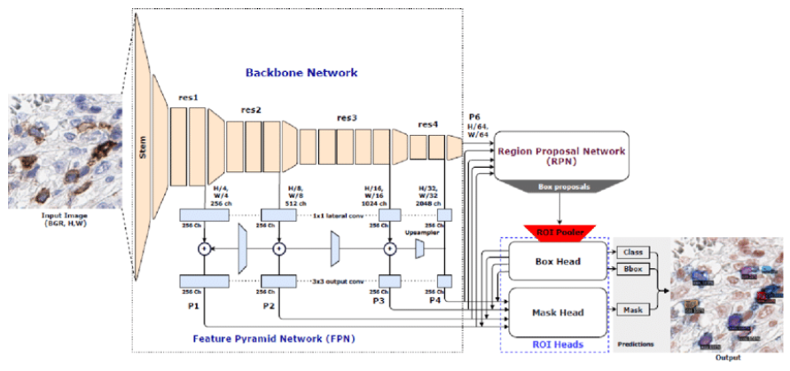
Detectron2:
Detectron2 is a powerful object detection framework that provides a collection of state-of-the-art models and tools. It combines efficient backbones, feature pyramid networks, and other advanced techniques to achieve high-performance object detection.

Slide 10
Industrial Application of Deep Learning:
Healthcare: Object detection algorithms can be used to detect and track various abnormalities in medical images, including tumors, fractures, and anomalies in blood vessels.
Transportation: Object detection can be used in various transportation applications such as traffic monitoring, pedestrian detection, and vehicle recognition.
Security: Object detection can be used in security applications such as surveillance, face recognition, and anomaly detection

Slide 11
Potential Development in Object Detection in Future:
More accurate and efficient algorithms
Improved object tracking
More robust detection in challenging environments
Real-time video analysis
Integration with other technologies
Development of specialized object detection systems

Slide 12
Current Limitations:
Limited Generalization
Limited Data Availability
Computational Cost
Limited Interpretability
Solutions:
Data Augmentation
Transfer Learning
Model Compression
Interpretable Models

